Slide 1

VoIP alarm monitoring

Slide 2



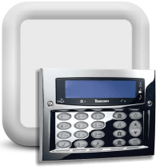


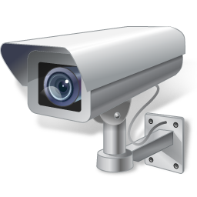
Traditional alarm systems
Motion sensor
ContactID protocol
Phone call
Fire station
Smoke detector
Phone call
Phone call
Premise Controll Unit
Central station
Camera
Security service
Devices send DTMF signals to PCU
Information flows through dial up phone line to central station
If alarm is not flase the central station notifies the fire- or security station

Slide 3
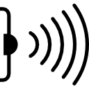


Weaknesses of traditional alarm systems
If an event triggers the PCU send alarms via dial up phone line to central station
In case a Phone line cut the PCU can’t dial and send the alarm to the central station

Slide 4
Advantages of using VoIP
Your office
Alarm monitoring company
Motion sensor
Phone call
Fire station
Smoke detector
ContactID protocol
VoIP Phone call
Phone call
Premise Controll Unit
Central station
Camera
Security service
Alarm signals are sent through a VoIP phone call to the central station

Slide 5
Advantages of using VoIP
Motion sensor
Periodic ping request
Phone call
Fire station
Smoke detector
VoIP registration
Phone call
Premise Controll Unit
Central station
Camera
Security service
With the help of the periodic ping request user can receive notification about network- and power failure
In this case the VoIP registration is not successful

Slide 6


Advantage of using VoIP
Motion sensor
Phone call
Smoke detector
Connection loss
Fire station
Phone call
Premise Controll Unit
Central station
Camera
Security service
User can setup a unique alarm system where the central station can send notification if the connection is failed with the PCU.

Slide 7
ContactID protocol
Standard way to notify central station
It is a 16 digit code with the data of the alarm
Contains:
  Object ID
  Partition ID
  Zone ID
Used by both: Traditional and VoIP alarm systems

Slide 8
The ContactID protocol time-line
ContactID handshake
Dial digits
ContactID 16 Digits
Dial Tone
ContactID kissoff
1 sec
250-300
msec
250 msec
Off hook
On hook
400Hz
Sent by PSTN
50
msec
50
msec
1400Hz
1400Hz
Sent by alarm system
100msec
100msec
Sent by central station
Repeat until all events are reported
Start with a 400 hz dial tone as an invite call which contains the authentication data in dial digits
If central station accepts these 1400hz and 2300 hz tones the ContactID handshake occurs
After the authentication the alarm system sends the ContactID
If the central station received a kissoff occurs.
This process repeats until all events are reported

Slide 9
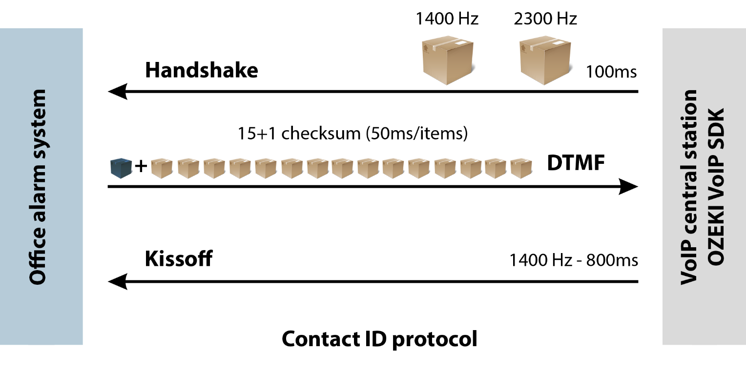
Try the example
If you wish to create your own VoIP central station you can do it by using a C# application + Ozeki VoIP SIP SDK

Slide 10
Analog Telephone Adapter (ATA)
Analog Telephone Adapter (ATA) is used to provide the phone line to the alarm system
It uses a G 711 codec to digitalize analog DTMF code to digital DTMF code which can be sent through VoIP network.

Slide 11
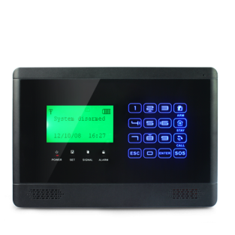
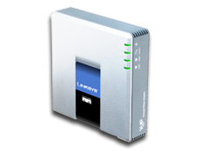


Switching from traditional system to modern
Replace old phone line with ATA
Connect your PSTN line to an ATA.
Use G 711 codec to transmit voice over IP
The central station will receive notifications through the internet

Slide 12



Solutions you can create using Ozeki
VoIP SIP SDK
Reliable
Compatible
Developer friendly
Create central alarm station
Build on-site alarm system
Create VoIP alarm service

Slide 13
Thank you for your attention!
For more information please visit:
http://www.voip-sip-sdk.com
or write us an e-mail to:
info@voip-sip-sdk.com

